Slide 1

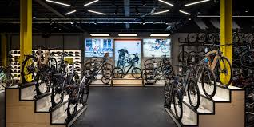
Bike Store Data Analysis Project
SQL Analysis of the BikeStores Database
Team Members:
Abhijith S D
Arvind C R
Ayyasamy S
Gurumurthy Kalyanpur Viswanathaiah
Manjunath

Slide 2
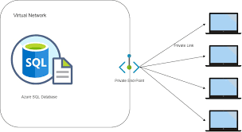


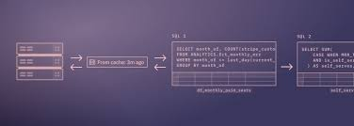

Project Overview and Setup
Objective:
- To provide actionable insights derived from the bike store dataset.
- To assist in making informed business decisions based on data analysis.
Dataset Overview:
- Scope - Data Import and Schema Overview, Data Analysis Using SQL (Descriptive Statistics, Data Cleaning, Aggregation and Grouping, Joins and Relationships, Use of Sub-queries, CTEs and Advanced Functions,), Insights and Conclusion.
- Dataset Includes - Brands, Categories, Customers, Order Items, Orders, Staff, Stocks and Stores details.

Slide 3
Technical Details on Project Setup
Environment Setup:
Connected to Azure Database for remote access
Azure Database Connection details:
Host: group3.mysql.database.azure.com
Port: 3306
User: group3
Project Directory:
Created a dedicated directory for the project files in GitHub. Included SQL scripts and data files.
Data Import:
Loaded the provided schema and data into the MySQL database.
Ensured all tables and relationships were correctly established.

Slide 4
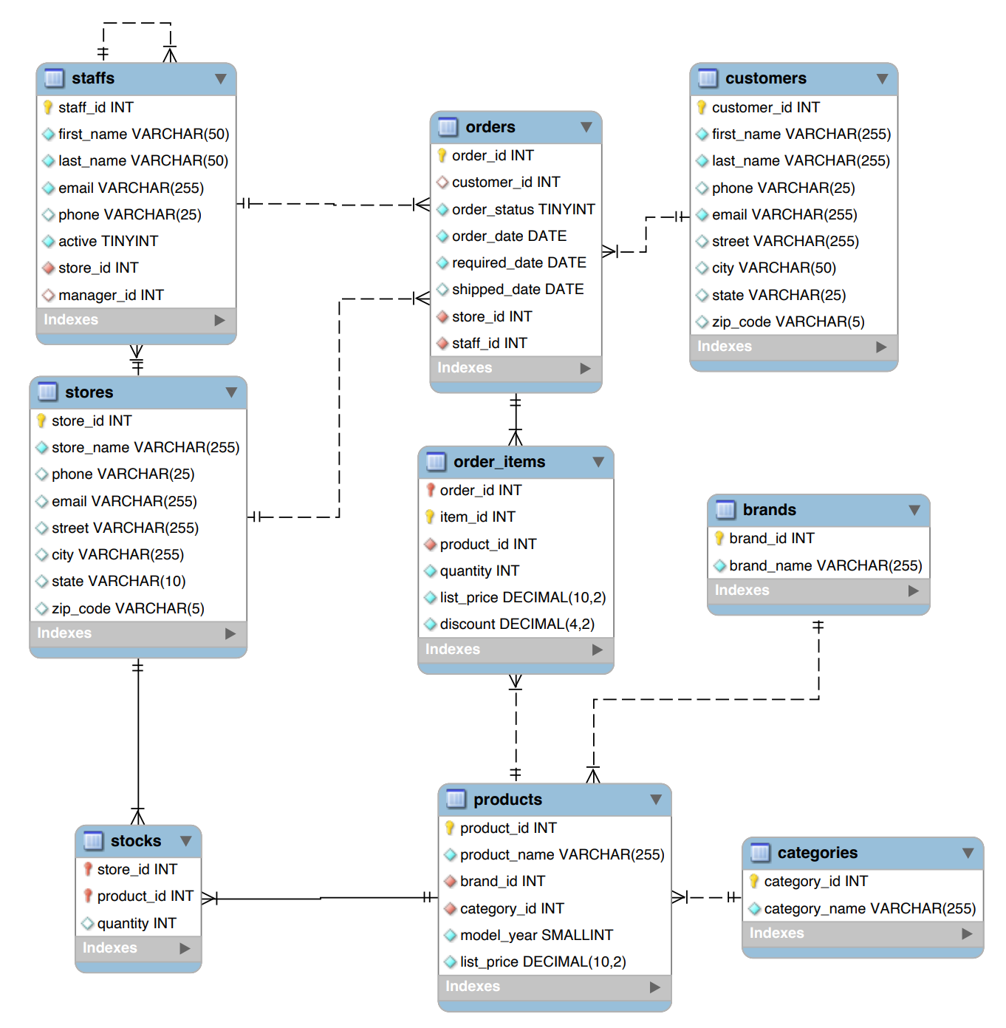
Entity Relationship Diagram
Entity Relationship:
1. Products belong to Brands and Categories.
2. Customers place Orders, which contain Order Items that reference Products. Orders are managed by Staff and linked to Stores.
3. Staff work at Stores and may manage other Staff.
4. Stocks track Products available at Stores.
SQLs Highlights:
The Entity Relationship Diagram (ERD) helps show relationships between tables like Customers, Orders, Products, and Staff using primary keys and foreign keys. SQL JOIN queries can be used to fetch related data from these tables.

Slide 5
Data Cleaning
Identified Issues:
Missing phone numbers in customers and staffs tables.
NULL values in shipped_date in orders table.
Cross validated duplicate customer records.
Actions taken:
Decided to retain entries with missing phone numbers to preserve data integrity.
Noted the missing shipped_date values for consideration in shipping time analysis. IS NULL keyword is used for finding missing data. Some values were retained for analysis purposes. Cleaning is done using UPDATE
Rationale:
Retaining records ensures a comprehensive analysis.
Missing values can inform about data collection processes and areas for improvement.

Slide 6
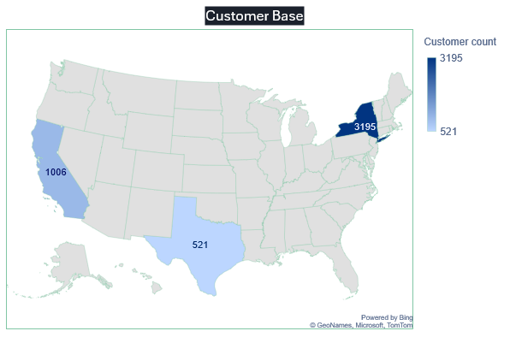
Customer Base
Regions: Customers are mainly distributed across New York, California and Texas.
Observation:
We have largest customer base in New York.
SQLs Highlights:
Aggregate functions like COUNT(), SUM(), MAX() & AVG() are used.
Group By the state column is used.

Slide 7
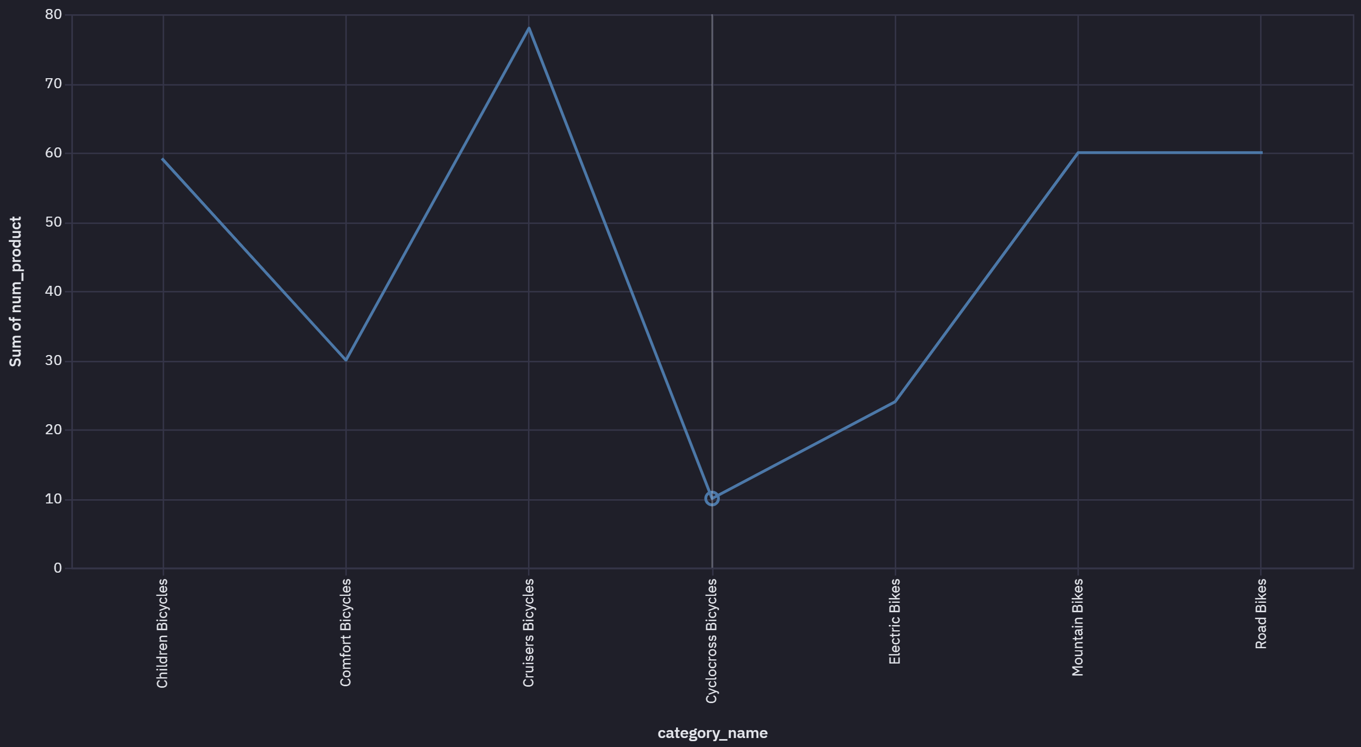
Products diversity across categories
Observation:
Cyclocross Bicycles and Electric Bikes seem to have lesser products diversity
Next Step:
Review the sales pattern if Cruisers Bicycles and Mountain Bikes really have demand across products range.
SQLs Highlights:
Group By and Order by used.

Slide 8
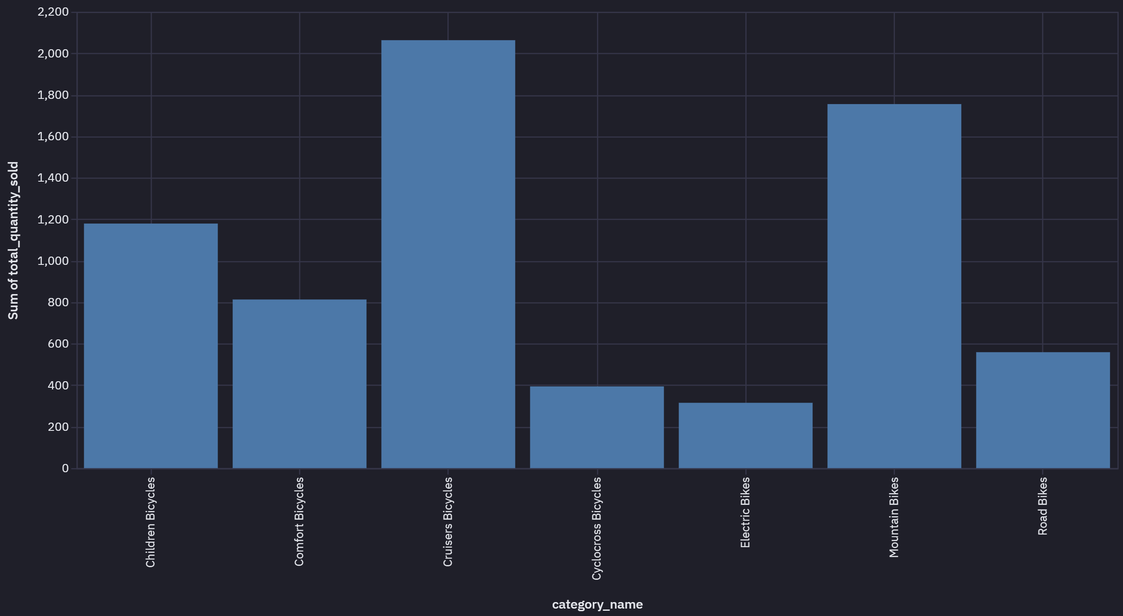
Sales Summary by Category
Context:
Sales Summary by Quantity across categories
Insight:
Observed higher sales in the categories of Cruiser bikes and Mountain bikes, possibly Cruiser bikes are used for leisure riding and are the most popular. Mountain bikes used for adventure cycling are also quite popular.
SQLs Highlights:
Group By clause has been used.

Slide 9
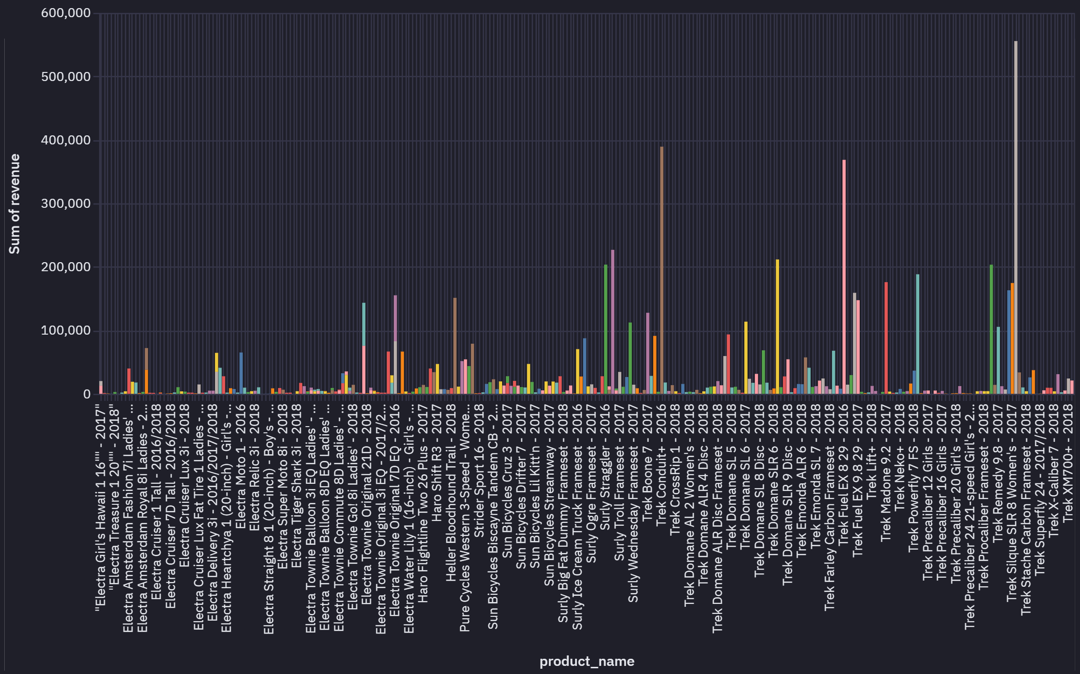
Sales Performance by Product
Context:
Total sales per product: Query to calculate the total sales amount for each product (considering quantity, list price, and discount).
Insight:
-- Trek Slash 8 27.5 = 2016 has been the highest revenue generating model amongst others.
-- Revenue (In Dollars) total_sales_volume as well as revenue_per_item
SQLs Highlights:
Used joins to connect order_items and products tables

Slide 10
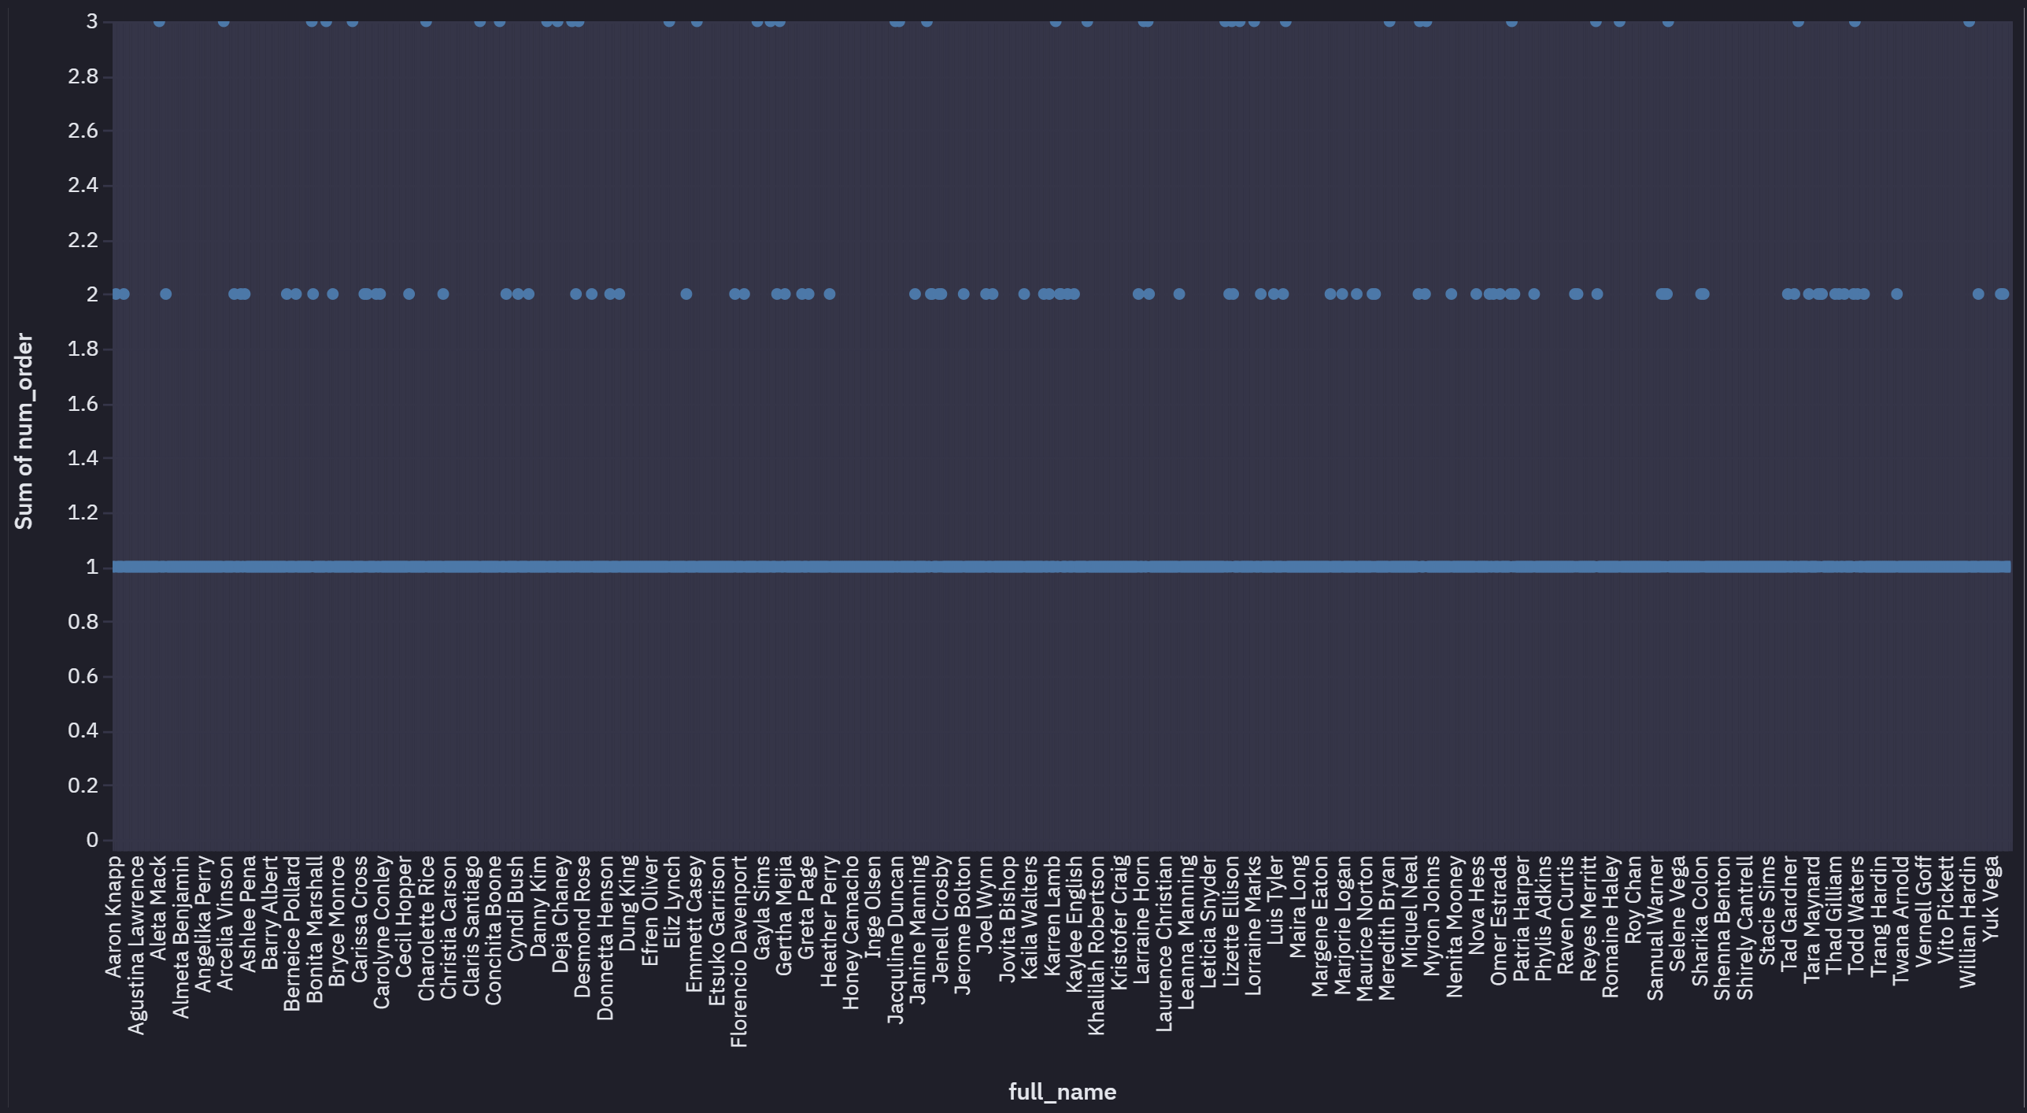
Customer Orders Count
Context:
Customer Orders across 3 years [2016 to 2019]
Observation:
Majority of customers order 1 bike/bicycle which is expected. Those who order 2 or 3 gradually decrease in frequency of orders.
SQLs Highlights:
Used Count() aggregate function to count number of orders

Slide 11
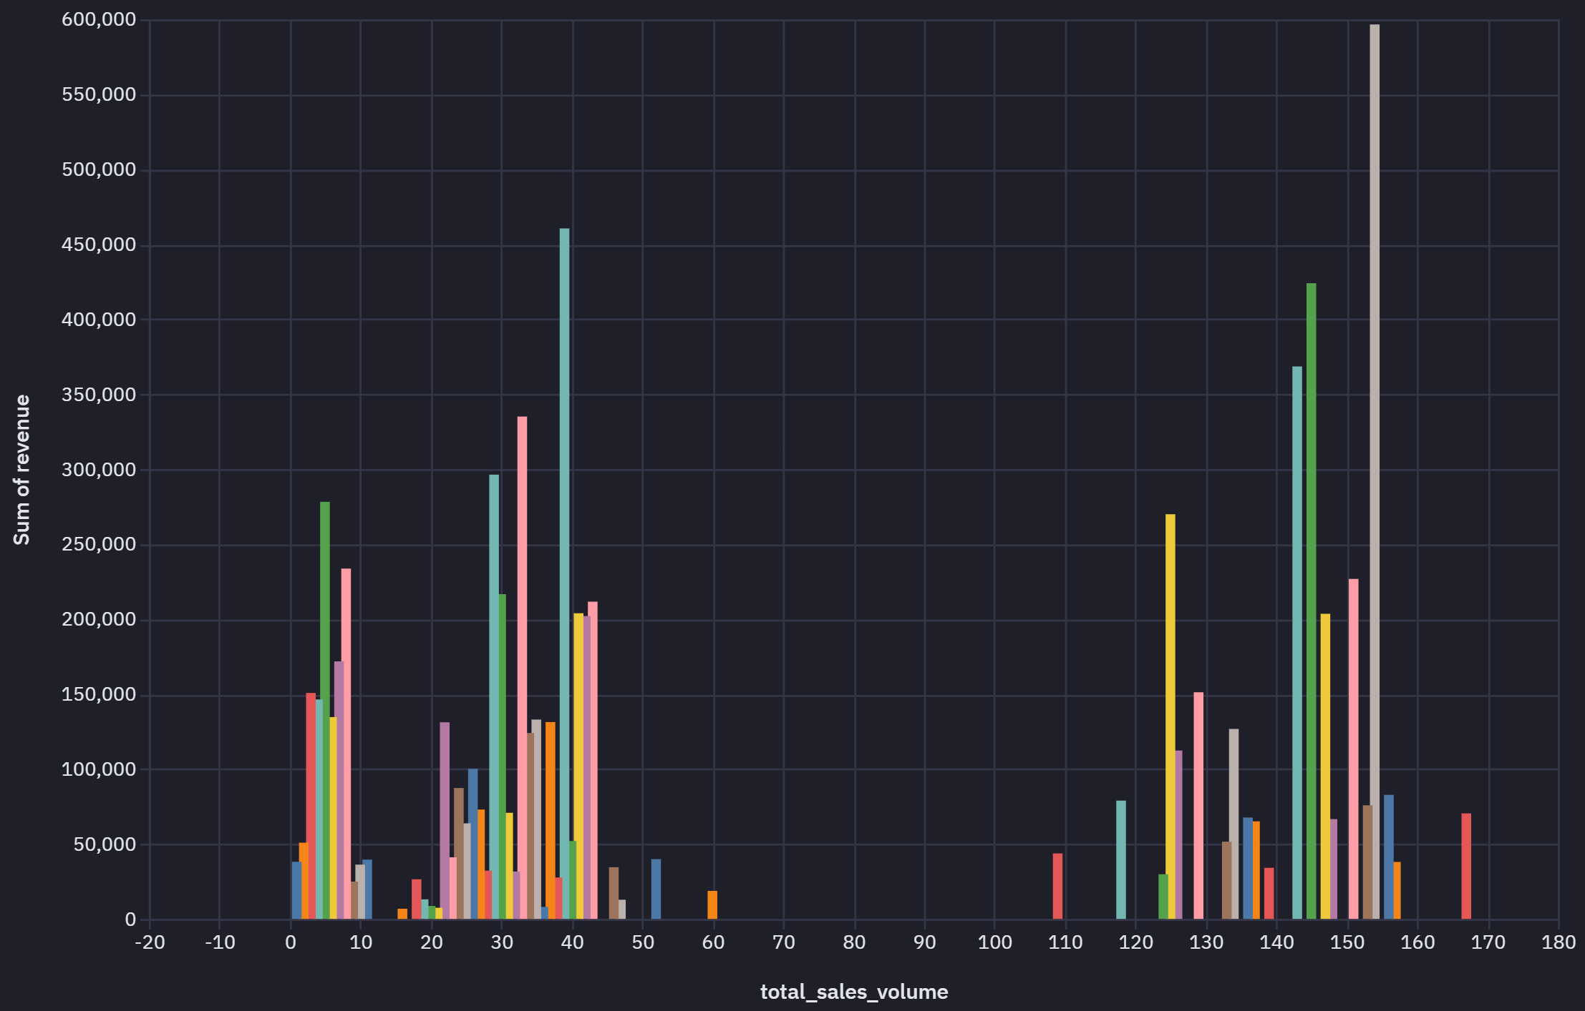
Sales vs Revenue Analysis
Context:
Sales in terms of quantity not necessarily generate higher revenue
Observation:
Sales in terms of quantity not necessarily generate higher revenue
SQLs Highlights:
Used SUM() to calculate the total revenue

Slide 12
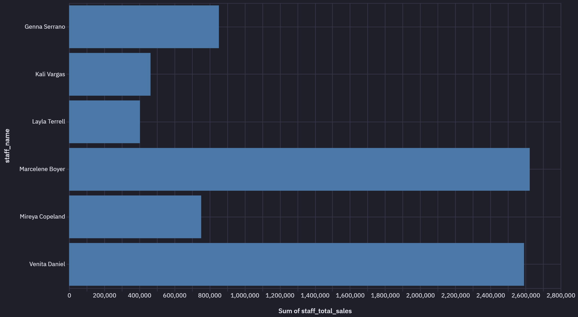
Sales Performance by Staff
Context:
Calculated total sales by staff member
Recommendation :
-- Staff can be incentivized or evaluated for performance based on the total sales numbers
SQLs Highlights:
We used inner join to combine Sales and Staffs tables Also grouped by staff_id

Slide 13
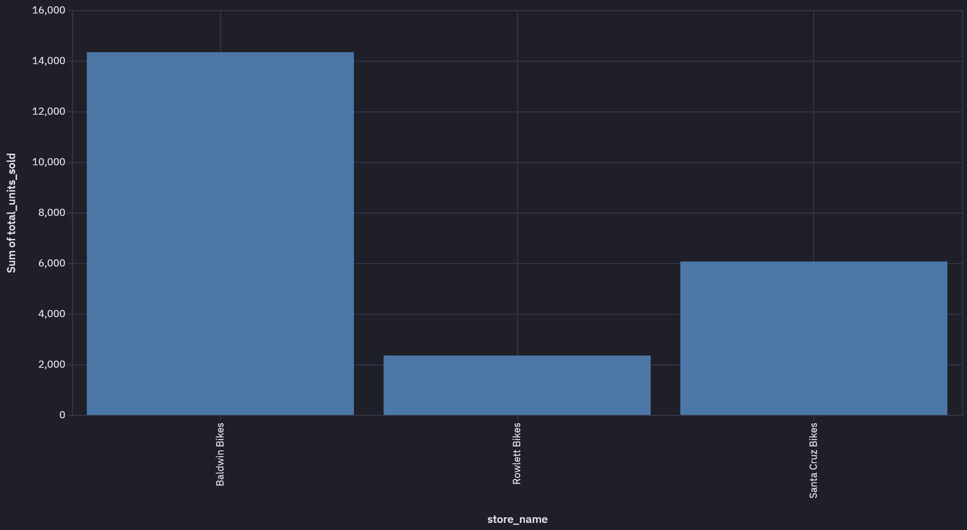
Store Performance Comparison
Context:
All the 3 stores have same number (3 excluding the over all head) of staff managing the sales.
Recommendation:
Baldwin Bikes has relatively higher sales so recommend resource rationalization by relooking under utilized staff in other stores.
SQLs Highlights:
Sales data is aggregated from each store with GROUP BY

Slide 14
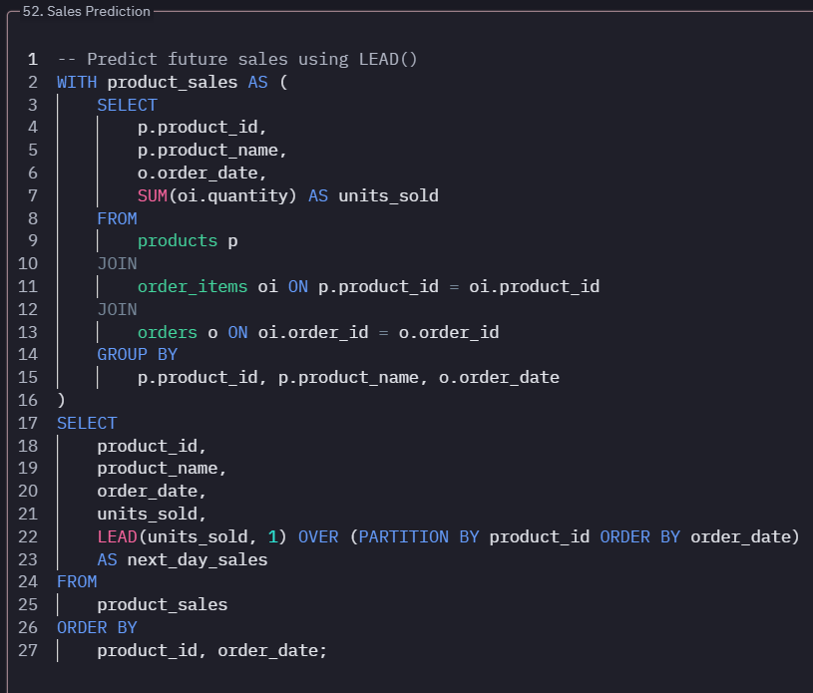
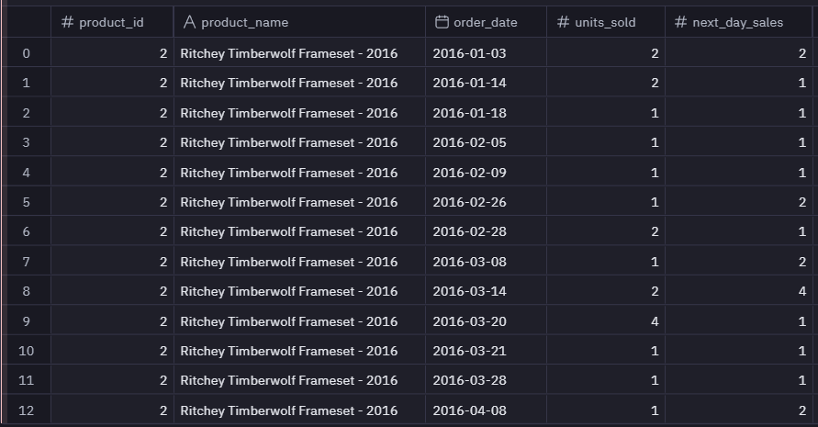

Sales Prediction for Inventory Re-stocking
Using this table, we can plan inventory restocking. LEAD() help to look at future data.

Slide 15
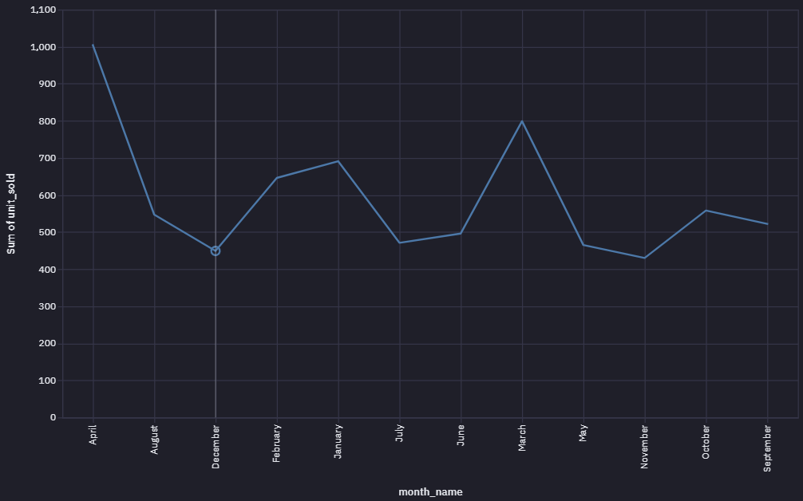
Trend and Seasonality Effect
Context:
Sales in terms of quantity not necessarily generate higher revenue
Observation:
Sales in terms of quantity not necessarily generate higher revenue
SQLs Highlights:
Used SUM() to calculate the total revenue

Slide 16
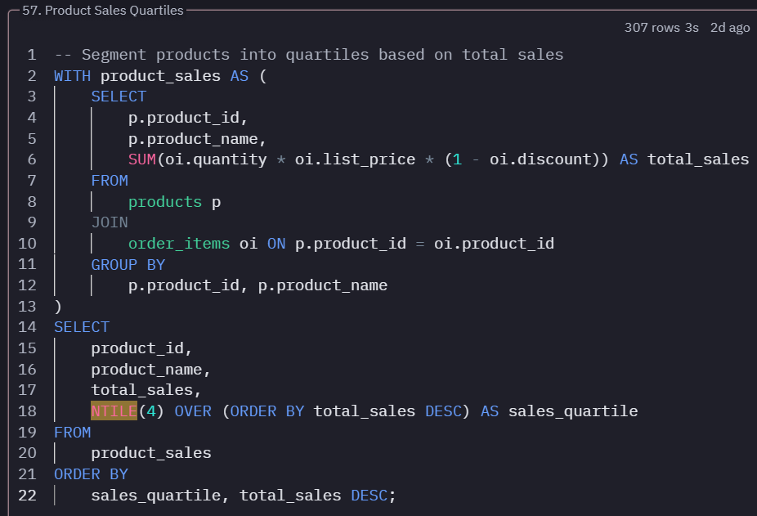
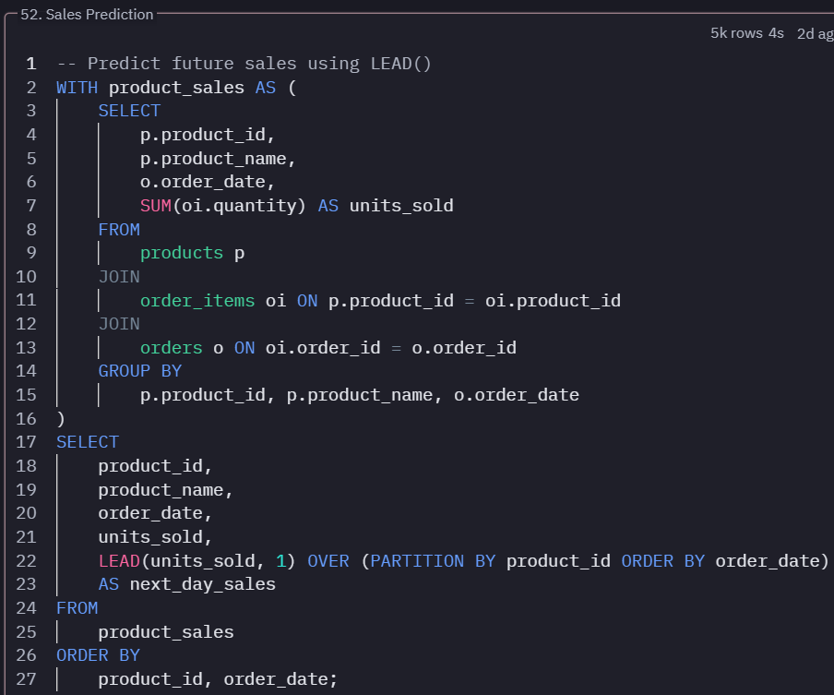
Use of Advance SQL Functions

Slide 17
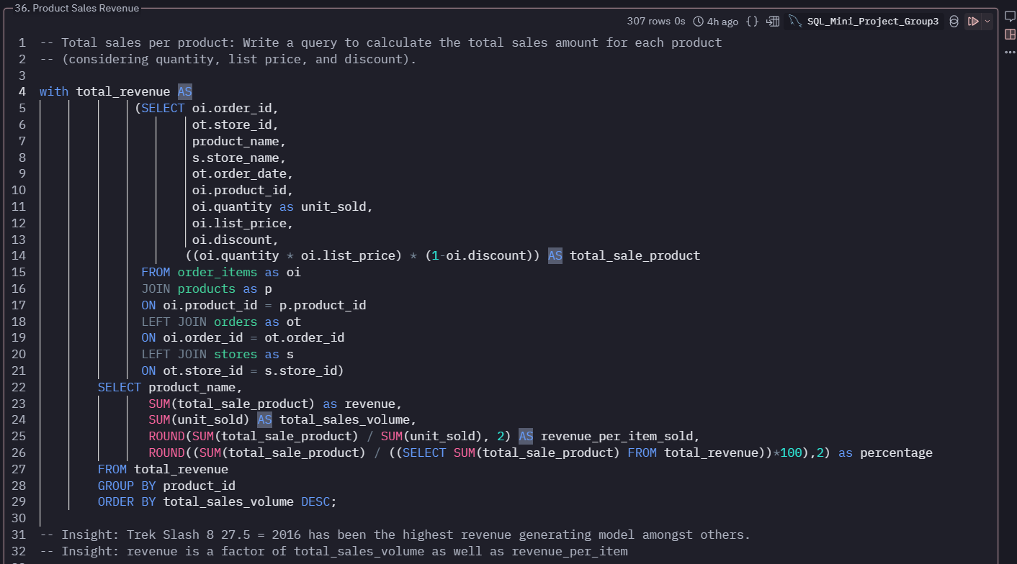
Use of several Sub-Queries and CTEs

Slide 18
Summary - Sales & Customer Data
1. Total Sales: $7.68 million across 1,615 orders, with an average customer spending ~$4,761.
2. Discount Strategy: An average discount of 10% is frequently offered to boost sales.
3. Customer Base:1,445 unique customers, suggesting a limited customer pool relative to potential market size.
4. Big Spenders: 17 high-value customers (who spend 65% or more than the top spenders), with a focus on premium products.
5. Customer Contact Information: A significant gap in phone contact details (1,267 missing out of 1,445), relying mainly on email marketing.

Slide 19
Summary - Inventory & Stocking
1. Popular Models: Trek Slash 8 27.5 (2016) is the highest revenue generator, while the Electra Townie Original 7D EQ (2016) has sold the most units (54 units).
2. Stock Replenishment:
- Items like Trek Domane SLR Frameset (2018), Electra Cruiser 1 Ladies (2018), Electra Superbolt 1 20” (2018), and Electra Townie Commute 8D Ladies' (2018) should be restocked as inventory levels drop.
- Focus on balancing inventory for high-volume items (e.g., Surly Ice Cream Truck Frameset - 2016) and high-profit items (e.g., Trek Conduit+ - 2016).
3. Brands Performance: Trek and Electra brands dominate product offerings, while Ritchey and Strider brands have fewer products, possibly needing increased variety.

Slide 20
Summary - Staffing Insights
1. Understaffing: Baldwin Bikes, despite high sales, only has 2 staff, indicating potential understaffing.
2. Staff Performance: Staff can be incentivized based on total sales numbers.
3. Manager Allocation: The ratio of managers to staff is low, and certain stores may not require as many managers (e.g., Fabiola manages herself without oversight).

Slide 21
Summary - Sales Trends & Supply Chain
Sales Trends: 1. Sales Fluctuation: Peak sales occur around May, June, August, and September, while April and July tend to see a decline.
2. Customer Re-Engagement: Post-June 2018 sales have declined. There is a need to re-engage older customers and investigate potential issues with order patterns.
Supply Chain & Order Management: 1. Order Delays: Baldwin Bikes has experienced delays in order fulfillment, with 112 orders delayed by two days and 205 by a day, suggesting room for optimizing the supply chain.

Slide 22
Recommendations
1. Focus on Premium Products: Luxury and high-ticket items generate the most profit, so they should be prioritized for restocking and promotions.
2. Increase Brand Variety: Consider increasing product offerings for brands like Ritchey and Strider to diversify stock.
3. Improve Customer Contact Information: Launch email campaigns to collect missing phone numbers from customers.
4. Balance Inventory: Regularly review and replenish stock for fast-selling and high-margin items.
5. Optimize Staffing & Management: Assess the need for more staff in high-performing stores like Baldwin Bikes, and streamline the management structure.

Slide 23
Bike Store Project Links
1
Bike store dataset link
2
Bike Store Repo - Github
Kaggle Link
Link to the project file.
Data Set – Github
3
4
READ-ME at Github
Link to Github dataset
Link to Github ReadME
5
Online Analysis Platform - HEX
6
HEX App Link
HEX Link
HEX App Link

Slide 24
Q&A

Slide 25
THANK YOU !!!

